Slide 1

Trend metal store
mk
Digital marketing specialist
TERMINATION
BELLY
Under supervision
Dr. Ahmed Shaheen
By :
Habiba Adel Hosny
Ahmed Anas Kiwan
Kerolos Essam Marzouk

Slide 2
chapter 1 introduction
BELLY
RING

Slide 3
Overview chapter1
Introduction
Problem statement
01.
02.
Solution Statement
03.
Vision
Mission

Slide 4
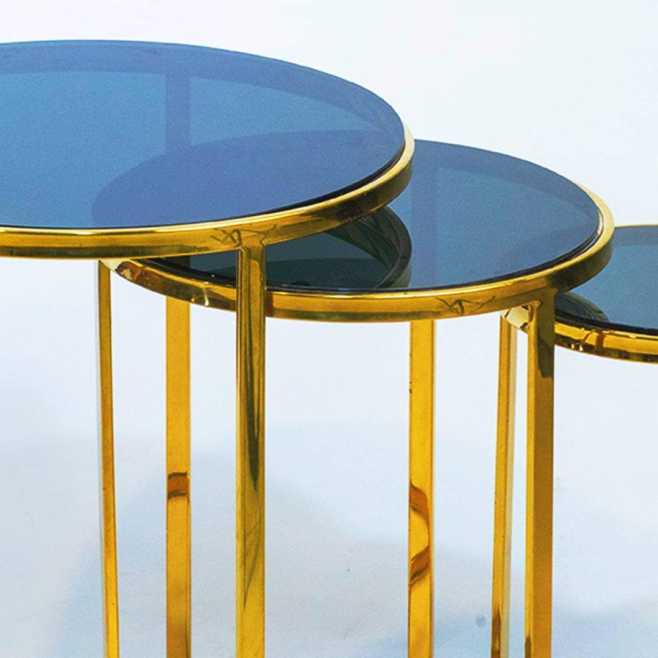
Introduction
National brand /make metal furniture
Trend Metal is a steel furniture store that offers customizable design services, allowing customers to personalize their furniture by making it from metal.
Trend Metal is currently an online store, aiming to offer customized designs, high-quality materials, and competitive prices. Our target market is Egypt, with a strategically chosen location in Cairo.

Slide 5
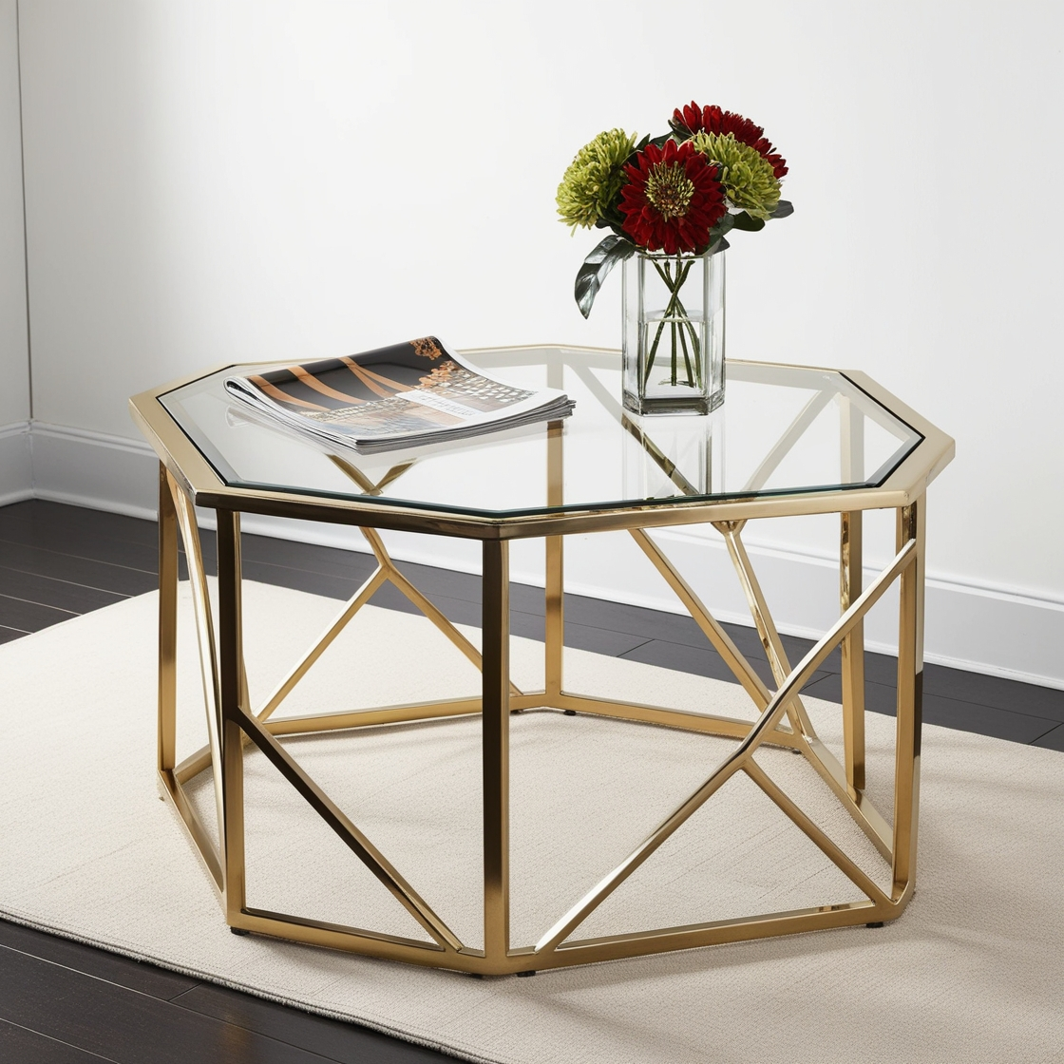
Business overview
National brand /make furniture steel
Trend Metal creates steel furniture with modern, unique designs, using high-quality materials at competitive prices.
Creating reels that tell the brand's story through the owner's storytelling, along with behind-the-scenes videos, to provide a personal and authentic view.

Slide 6
Problem statement
Customers need long-lasting furniture that can endure these elements without frequent repairs or replacements.
Dissatisfaction among buyers who want both modern, sophisticated designs and the resilience required for long-term use.
The market lacks easily accessible, customizable steel furniture options to fulfill these needs.

Slide 7

Vision
Mission
Create a world where every home showcases individuality and elegance designed stainless steel furniture.
We envision a community share our passion for quality, innovation, stainability, where together we set new standards for luxury living.
Our commitment to exceptional craftsmanship and customer care inspires us to continually evolve, ensuring.
At trend metal, we believe that your home deserves to reflect your unique style and values. Our mission is to craft luxurious, high-quality stainless-steel furniture that not only enhances your living space but also aligns with your commitment to quality and sustainability. We are dedicated to listening to your needs, addressing your concerns, and ensuring that every piece we create brings you joy and satisfaction.

Slide 8
chapter 2 strategy Planning Process
BELLY
RING

Slide 9
Overview chapter2
Marker research
Marketing objective
01.
02.
Marketing strategy
03.

Slide 10
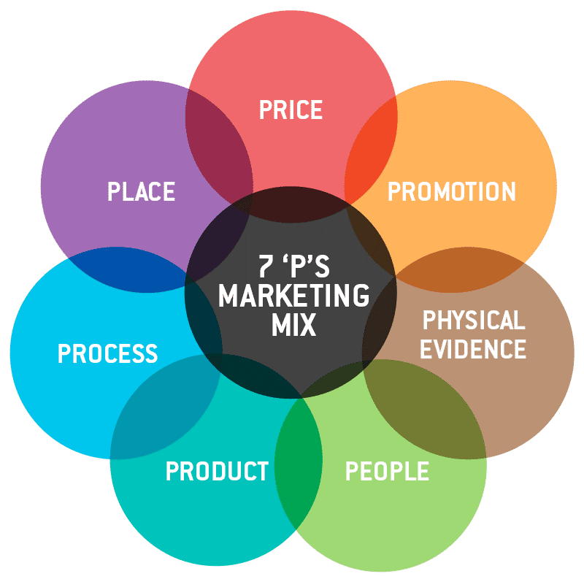
1. Market research
Cost effective pricing strategy paying methods: cash, E wallets, and instapay.
Offer tailored pricing for customized designs based on the level of personalization required
Showrooms
Online Presence
Collaborate with interior designers and architects.
Primary social media (Facebook –Instagram) content marketing
paid ads on Facebook and Instagram
partnership
Secondary channels: website, TikTok, and Pinterest
Customization Process to create personalized pieces.
Provide tracking options and updates to customers regarding their orders.
warranties, maintenance tips, and after-sales services that reinforce the durability and quality of the furniture.
word of mouth
Recommendations
Fast purchase
Online Experience
Packaging
Offering a wide range of modern, minimalist designs for luxury residential homes, hospitality sectors, and corporate offices
Feedback &customer care
Interior Designers and Architects
Sales Staff

Slide 11

1. Market research
Competitor analysis
Click me

Slide 12
1. Market research
SWOT Analysis
Strength
Opportunity
Customizable designs
Excellent after-sale support
Trendy and modern pieces
Suitable and fair prices
Good location
Increased demand for steel furniture and modern style
Paid partnership with Interior designer
Continuous availability of products
Fast shipping and meticulous product packaging attention.
Weakness
Threaten
The brand is new in the market
Lack of awareness of the target audience about the brand
Low budget ( for advertising )
There is no history about our clients
Changes in economic conditions
Increase competition in market
Less of designs in pages
Change styles of customer

Slide 13
Main objectives
2. Market objective
Increasing the public’s awareness
Differentiating from competitors by providing unique content
Attracting customers interested in making their own designs
Increasing the selling on website
SPINE

Slide 14
Goals
Increased number of followers and reach by 10% in month
Increased visitor on website 10% in month
Special offers on products
Increased sales volume by 10% within 3 months

Slide 15
unique selling points
Quality Materials
Create your own design
Competitive price for materials
Customer service

Slide 16
Segments
3. Market Strategy
Interior Designers and Architects
Demographics
Psychographics
Age: 30-50 years
Gender: Both male and female
Income Level: High, (from 40,000 per year)
Education: Degree in architecture, design, or interior decoration
Occupation: Interior designers, architects, creative professionals
Nationality : Egyptian
Values creativity, uniqueness, and high-quality materials
Enjoys working on high-end projects, often for affluent clients
Interested in modern, minimalist, or industrial design aesthetics
Behavioral
Geographics
Prefers personalized: services, showroom visits, and samples before making large purchases
Media Consumption: Follows design magazines, Pinterest, Instagram, and design blogs like Dezeen
Buying Behavior: Prioritize quality and competitive price
Decision Making: Extended process for customer and engineer
Brand Loyalty: Favor reputable luxury brands and developers
Location: Giza &Cairo
Preference: Urban/ modern
Proximity: Seek tranquility near new departments

Slide 17
Segments
3. Market Strategy
High-End Renters
Demographics
Psychographics
Age: 28-45 years
Gender: Both male and female
Income Level: EGP 250,000-600,000 annually
Occupation: Professionals, expatriates, high-earning young couples
Nationality: Egyptian
Looking to elevate their rental spaces without permanent modifications
Values quality, portability, and aesthetics
Behavioral
Geographics
Goals: Create a sophisticated living environment without committing to permanent fixtures
Shopping Habits: Prefers online shopping with fast delivery and modular furniture options
Media Consumption: Engages with YouTube reviews, Instagram influencers, and luxury home websites
Decision Making: Extended process couple make new house
Brand Loyalty: Favor reputable luxury brands and developers
Location: Giza &Cairo
Preference: Urban/ modern
Proximity: Seek tranquility near new departments

Slide 18
Segments
3. Market Strategy
Commercial Office Spaces
Demographics
Psychographics
Age: 35-55 years
Gender: Both male and female
Income Level: Medium to high, EGP 500,000+
Occupation: Office managers, co-working space owners, CEOs
Nationality: Egyptian
Focus on creating modern, professional workspaces
Values functionality, sleek design, and long-term durability
Behavioral
Geographics
Goals: Create a workspace that promotes productivity and impresses clients
Shopping Habits: Works with interior designers, prefers modular and ergonomic furniture
Media Consumption: Reads business and entrepreneurship magazines, follows LinkedIn influencers
Decision Making: Extended process CEOs make new office
Brand Loyalty: Favor reputable luxury brands and developers
Location: Giza &Cairo
Preference: Urban/ modern
Proximity: Seek tranquility near new departments

Slide 19
Buyer persona
BELLY
RING
COUNTERFORM

Slide 20
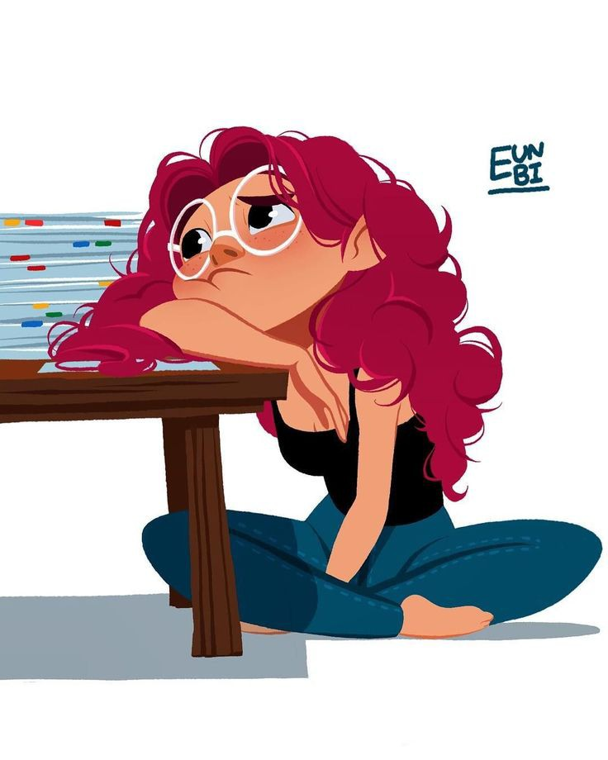



About
Pain points
Limited choices of stylish, modern furniture
Concern about investing in high-end furniture that may not last or fit well with changing trends.
Difficulty in finding customizable options
Finding furniture that reflects their personal style
Mostly married or in long-term relationships, often with young children or planning to start a family and make his house she has a unique style and loves modern style.
Mariam
Habits &interest
Challenge
Interested in flexible payment options
customizable products that can be adapted to their own need
modern and unique style furniture
Finding furniture that combines elegance, functionality, and durability
Need for premium, movable furniture that fits within their rental agreements
45
Goals
Communication channels
Cairo, Giza
Make new homes with modern, luxurious pieces that match their vision.
provides long-term value—durable, timeless, and easy to maintain.
create a home environment that reflects their success and personality.
recognized for having a stylish and unique home that impresses visitors.
Instagram
Pinterest
YouTube for interior design inspiration and trends.
Engagement and married in short term

Slide 21
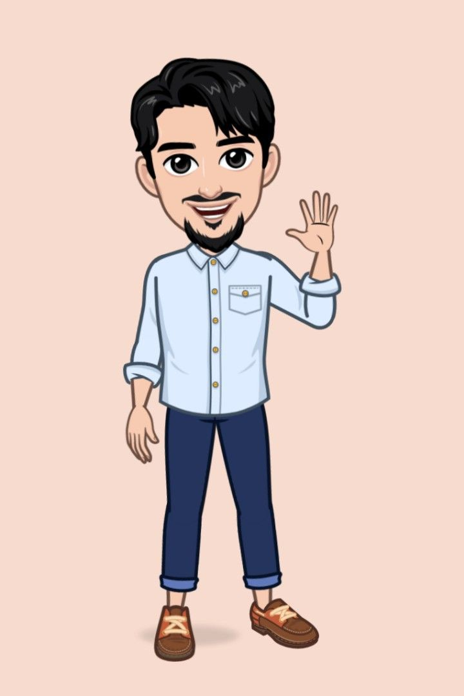
About
Pain points
interior design influence in couple to make her own house with her styles and give their couple his opinion
Finding furniture pieces that can be customized to fit their projects.
They require furniture that can withstand long-term usage .
Their clients demand luxury,
Increasing pressure to choose sustainable materials.
Eng: Hossam
Habits &interest
Passionate about architecture, modern art.
They keep up with global design trends and constantly seek out innovations in furniture design.
Challenge
Need for customizable
durable furniture that blends with different design styles
meets clients’ luxury standards
39
Goals
Communication channels
Cairo, Giza
Create Impressive Spaces: design sophisticated and impressive spaces for clients, adds value to their design projects.
Customization: customized to fit specific room layouts or meet the stylistic preferences of their affluent clients.
Luxury Standards: Ensuring the materials and furniture pieces they source meet high luxury standards.
Social Media: Instagram and Facebook
Website & Portfolio
Showrooms & Trade Shows
Engagement and married in short term

Slide 22
Value proposition
3. Market strategy
Exceptional Customer Experience: providing customized styles for all styles homes Excellent
Customer Support: Provide personalized and prompt assistance to clients, being available to answer inquiries and help them achieve their goals and solve for all customers pain points
SPINE

Slide 23
3. Market strategy
Positioning
MULTI GENERATIONAL
ENTERTAINMENT
UNIQUE & DIFFERENT
High material and competitive price
CUSTOMER SERVICE
PAYMENT
FACILITIES
Customized designs

Slide 24
Digitals Tools
3. Market strategy
Canva: for designs and videos
Leonardo.ai: for product photos
Buzz sumo: for meta analytics
ChatGPT: help with brainstorming content ideas
Meta ad library: for Facebook ads
Similar webs: for website analytics
Looka: for logo
Prezi: for presentation
Notion
SPINE

Slide 25
chapter 3 Branding
BELLY
RING

Slide 26
Overview chapter2
Positioning statement
Brand Mantra
01.
02.
Brand Elements
03.
Color Pattern
04.
Social media channels
05.

Slide 27
1. Positioning statement
For all customer we provide steel furniture that combines premium aesthetics with lasting durability, our steel furniture offers customizable, high-end solutions that stand the test of time. From contemporary design to sustainable luxury, we help you create spaces that impress and inspire.

Slide 28
2. Brand Mantra
"Timeless Design, Enduring Strength"
Emotional Modifier
Descriptive Modifier
Brand Functions
luxury and long-lasting value
Customizable Steel
Premium Quality Furniture

Slide 29
Brand Analytics
2. Brand Mantra
1
Core message | Every piece tells a story | satisfied customers
Type of content | Awareness, engagement | selling
Type of posts | storytelling UGC / reels | posts / stories
Channels | Facebook Instagram | web site TikTok
3

Slide 30

3. Brand Elements
Slogan
Luxury in Every Line, Strength in Every Piece
Name
Logo
Character
Trend metal
Plant in steel describe the business quality

Slide 31
Brand voice
3. Brand Elements
Luxury
comfortable
sophisticated
Trustworthy
Professional
customized

Slide 32
3. Brand Elements
Brand Voice
We communicate with confidence , Our language reflects the luxury and premium nature of our furniture, maintaining a refined and elegant style. We encourage creativity and innovation, integrating steel furniture into their high-end designs. We prioritize reliability and quality, assuring that our products deliver long-lasting value and craftsmanship. Our voice showcases authority in design and craftsmanship, We engage in conversations, showing openness to customization, understanding that each project is unique and requires tailored solutions.

Slide 33
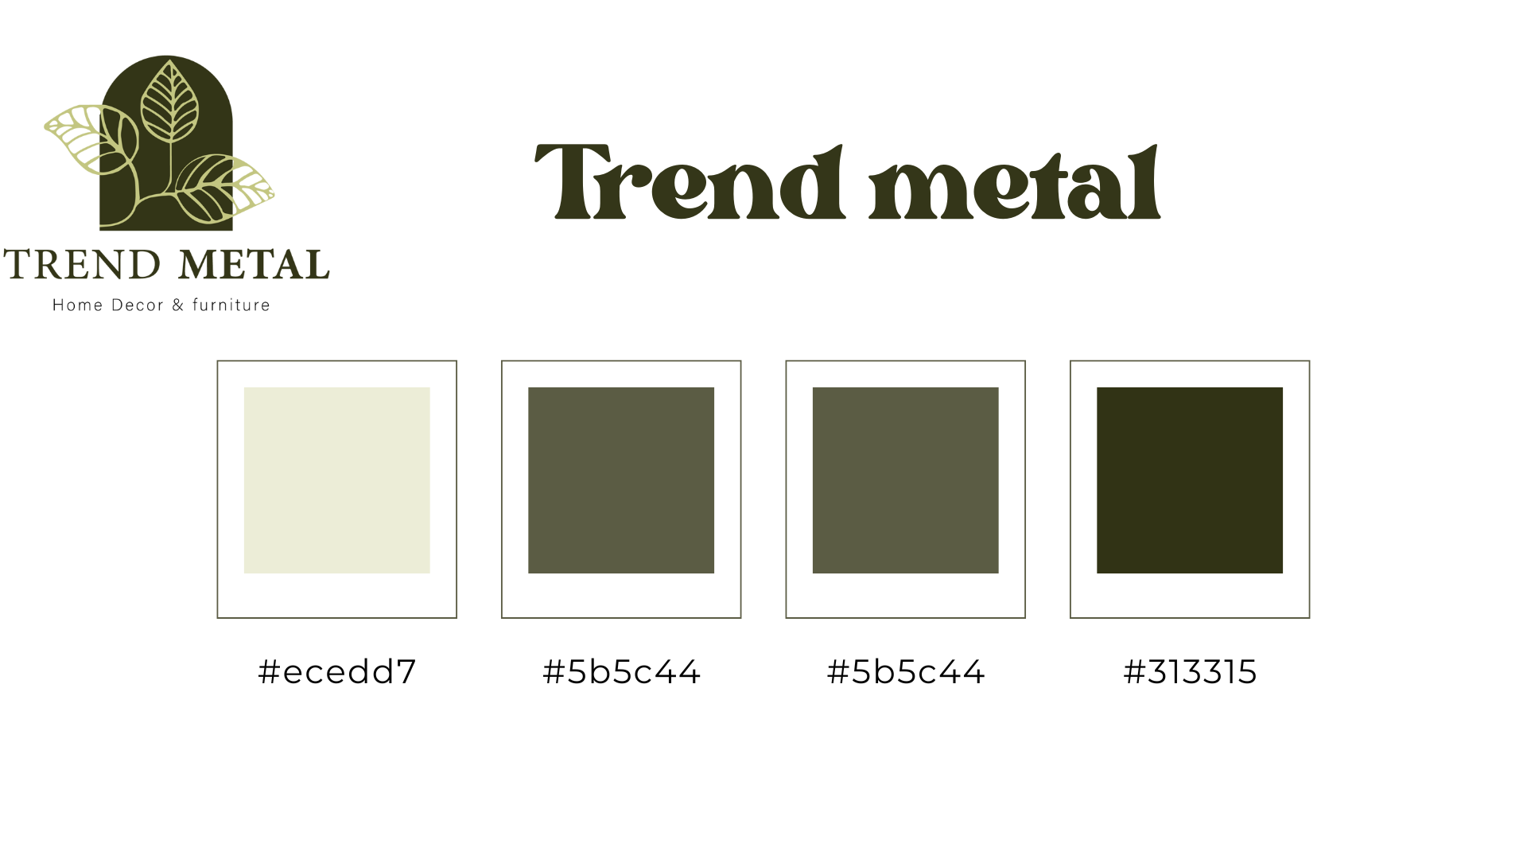
3. Brand Elements
Dark green :indicates rivalry , ambition and , adaptable
Deep gold : represents prosperity
Cream : represents acceptance , tolerance and maturity. charming thoughtful, gracious

Slide 34

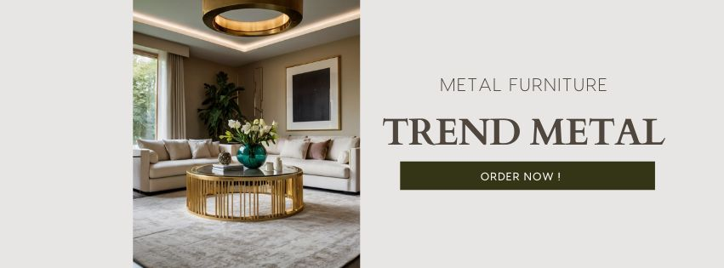

4. Social media channels
About
For homeowners seeking modern, elegant furniture, Trend Metal offers customizable metal pieces that reflect your style. With durable PVD coatings, our designs are both trendy and long-lasting. Transform your home with stylish, durable metal furniture.

Slide 35
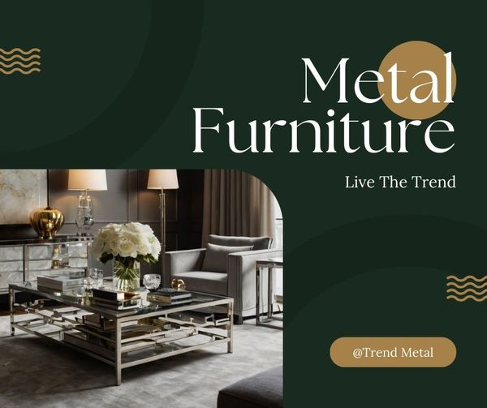
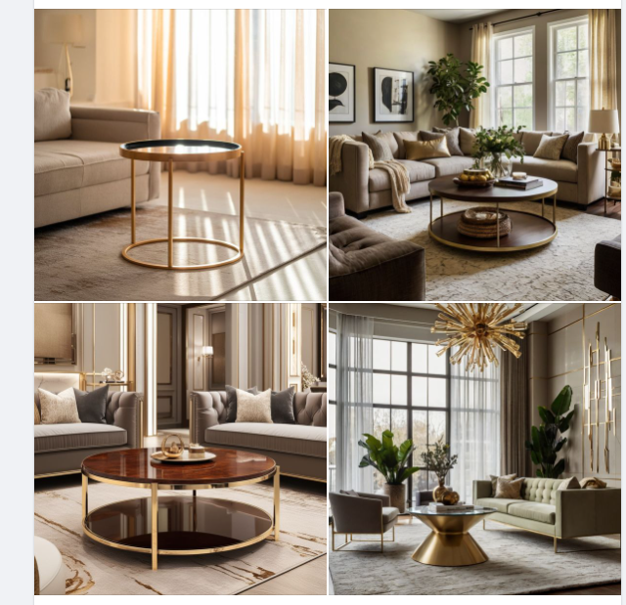
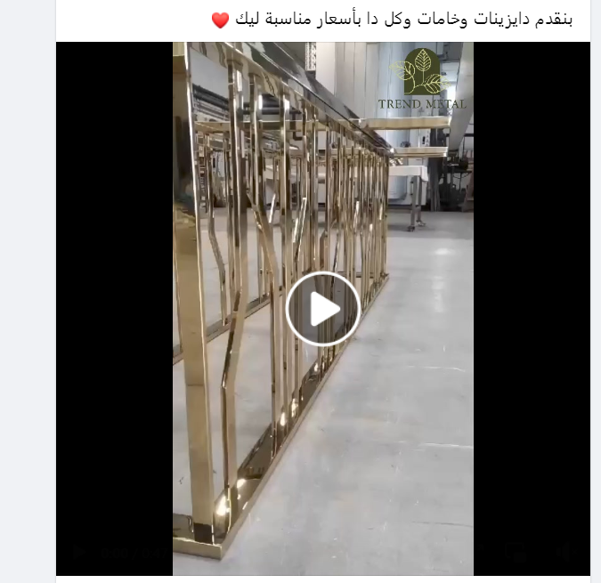
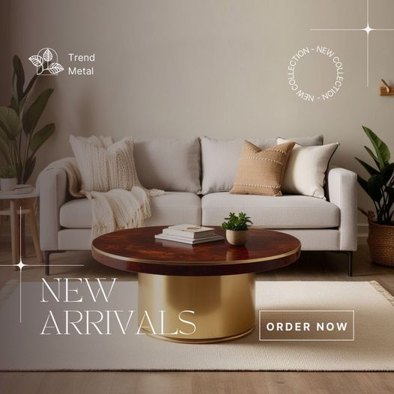
Facebook posts

Slide 36
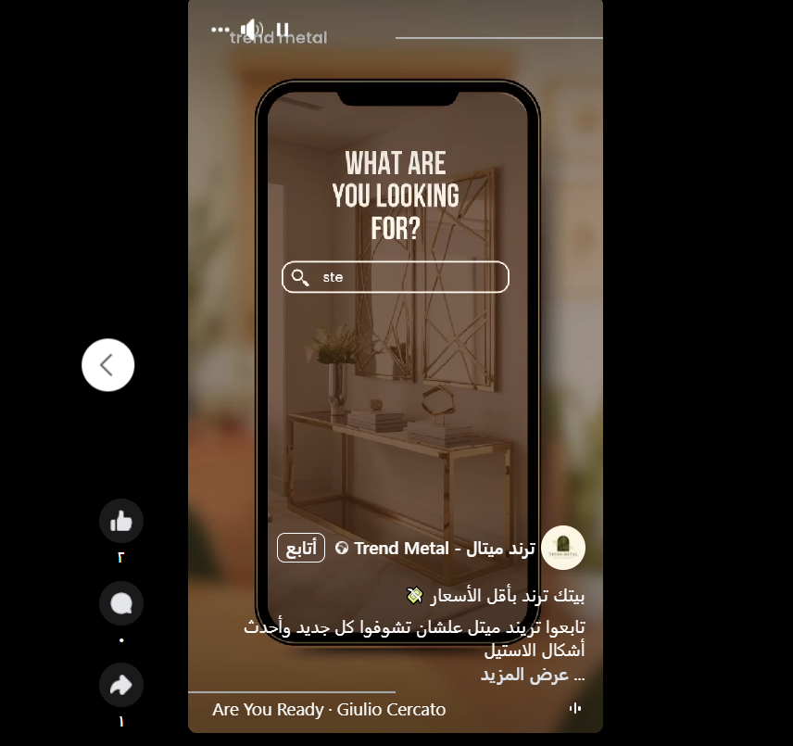
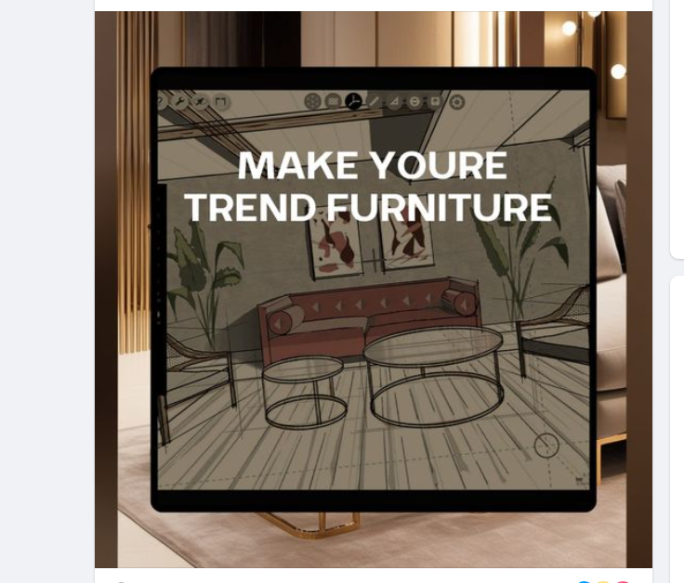
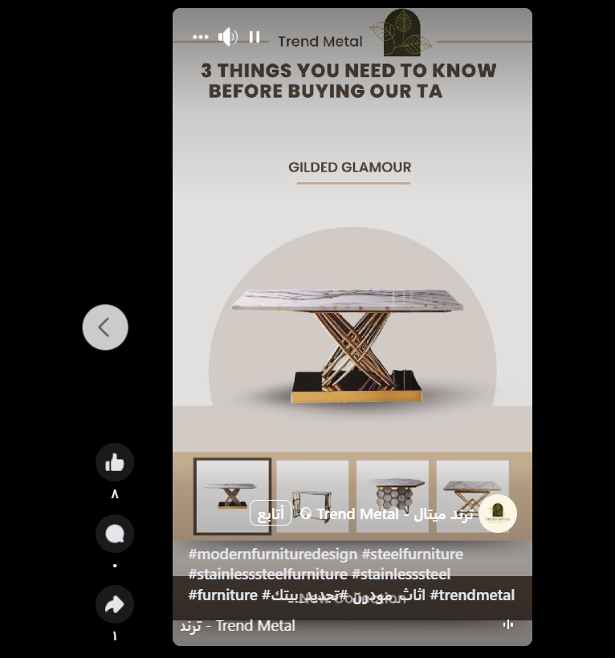
Facebook posts

Slide 37

4. Social media channels
About
Trend Metal
Metal furniture Brand
We create distinctive pieces for you that can change your home space for the better🤍

Slide 38
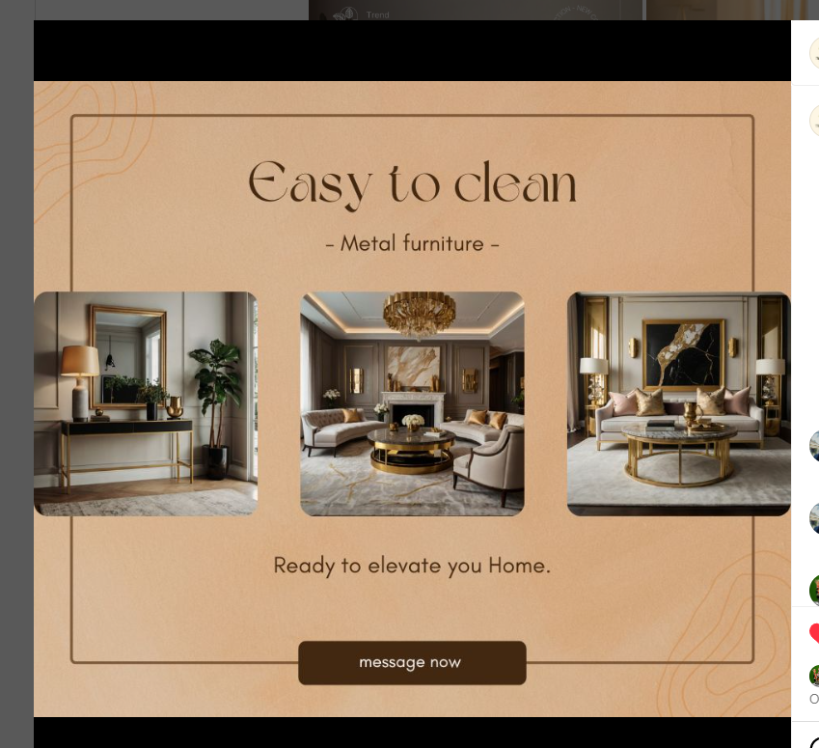
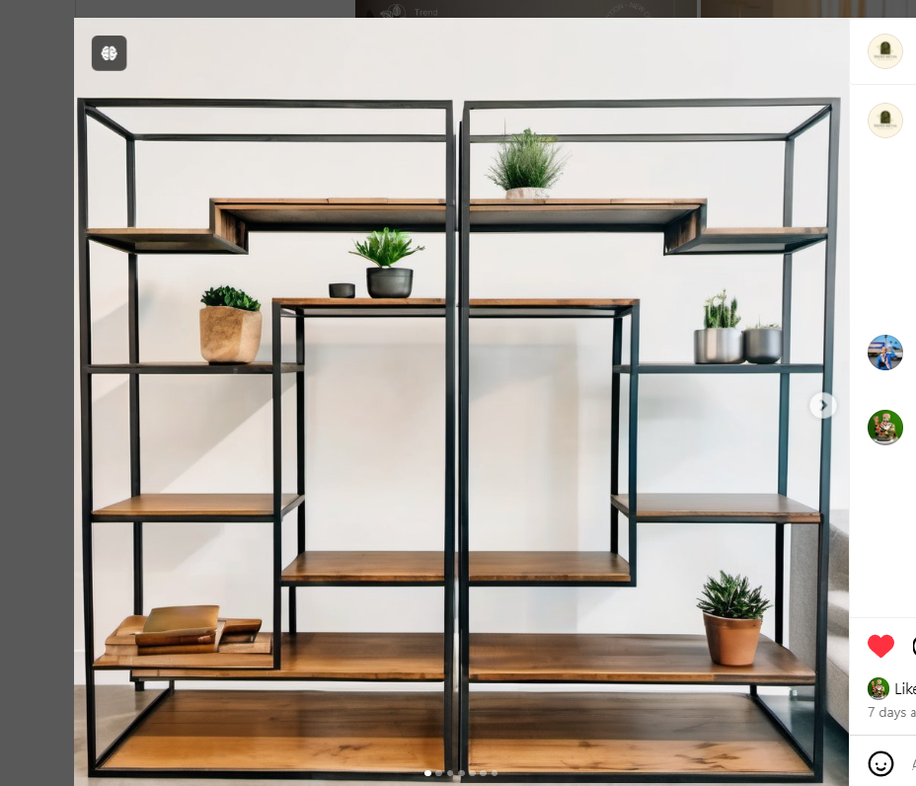
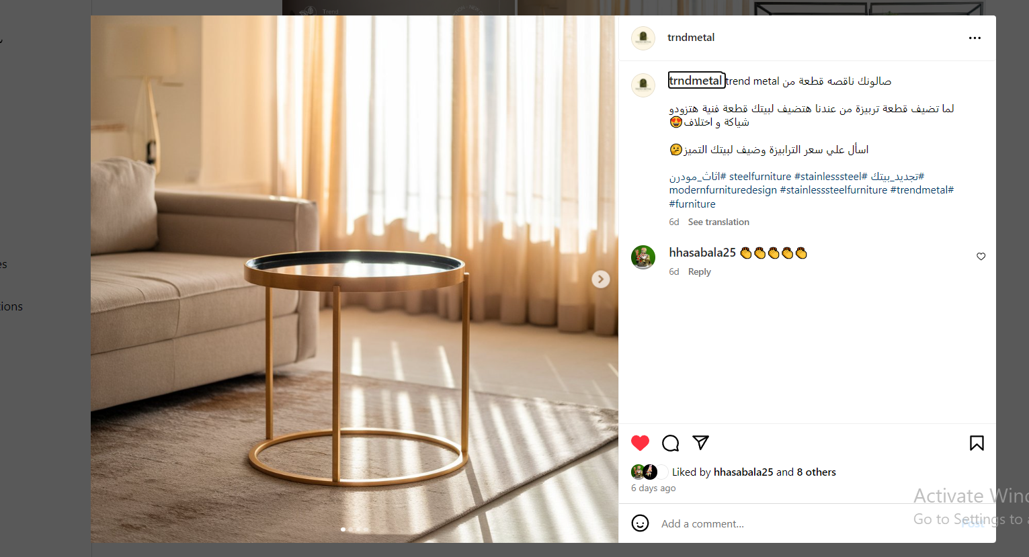
Instagram posts

Slide 39

4. Social media channels
Make website to show our catalog

Slide 40

4. Social media channels
We will make it if our main social media Instagram and Facebook reach to 5k engagement

Slide 41

4. Social media channels
We will make it if our main social media Instagram and Facebook reach to 10k engagement

Slide 42
Our main channels
4. Social media channels
Facebook | Instagram
Rewrite bio, make sitting. Change the cover and profile, then publish the content. | Create reels related to the business owner. Awareness and sales posts. Rewrite bio , website, and highlights

Slide 43
chapter 4 Channels
BELLY
RING

Slide 44
Overview chapter2
Content Marketing
Social Media
01.
02.
Facebook Ads
03.
Analytic
04.
05.
What makes us Speacial

Slide 45
1. Content Marketing
Objectives
Raising brand awareness.
Attracting potential customers.
Boosting sales.
Buyer journey stages
Awareness Stage: Content that grabs attention for the first time and build brand awareness.
Consideration Stage: Content that highlights the property's features and helps the client consider purchasing.
Decision Stage: Content that motivates the client to make the final decision, such as special offers or customer testimonials

Slide 46
1. Content Marketing
Platforms Depending on the chosen segments
1. Facebook: A wide audience, utilizing text posts, images, and promotional videos.
2. Instagram: Targeting through attractive images and short videos.
3. TikTok: Using short videos for interactive and creative promotion.
4. Linked in : using article for make interactive posts in CEOs and managers

Slide 47
Types of content
1. Content Marketing
Display different stages of the project
Compare between your house with steel furniture and traditional furniture
Show how to manufacture each piece.
03
04
05
01
02
06
How to use steel furniture in each style of house.
Publish certificates from clients
Compare between each kind of steel

Slide 48
Action plan task
1. Content Marketing
01
02
03
Change the bio to fit the position we do.
Create content "About the Project”, which defines the steel furniture.
Highlights Instagram
04
05
06
Focus on content suitable for target audiences
Highlight the unique designs
Highlight the unique designs

Slide 49
Action plan task
1. Content Marketing
07
08
09
Video work on how make piece of furniture
Create content that explains how AI can help you show piece of steel furniture in his style house
Q&A content with the followers, interior design
10
choice tagline & slogan

Slide 50
2.Social media

Slide 51
Content calendar
2.Social media content
Click Me

Slide 52
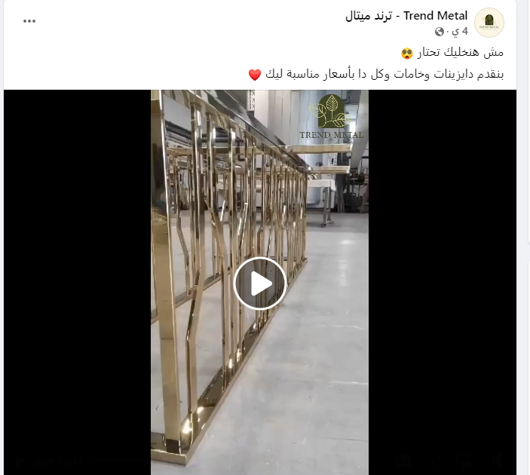
3. Facebook Ads
Overview of the Campaigns
Objective: lead generation
Ad Formats Used: lead ads with the conversion location set to Messenger.
First Campaign
Age: 25-34
Location: Cairo - Giza
Interests: modern steel furniture
Demographics: University graduate - Parents

Slide 53
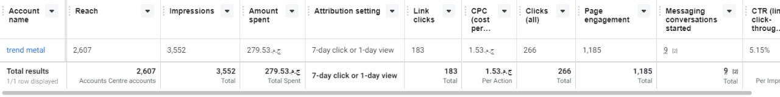
3. Facebook Ads
Key Metrics & KPIs

Slide 54
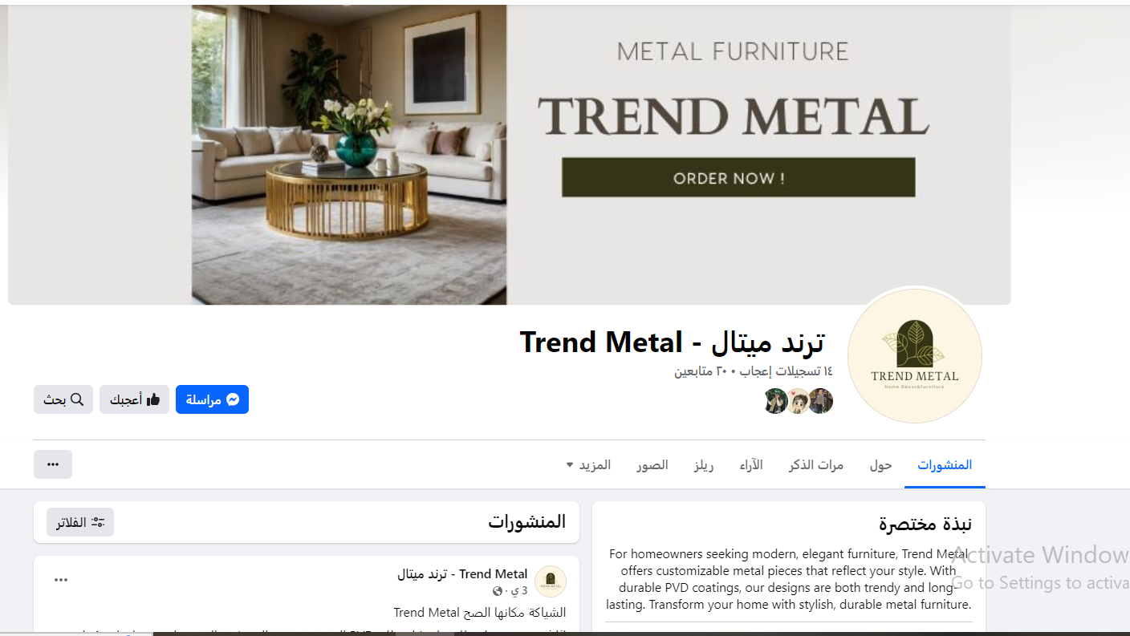
4. Analytic

Slide 55
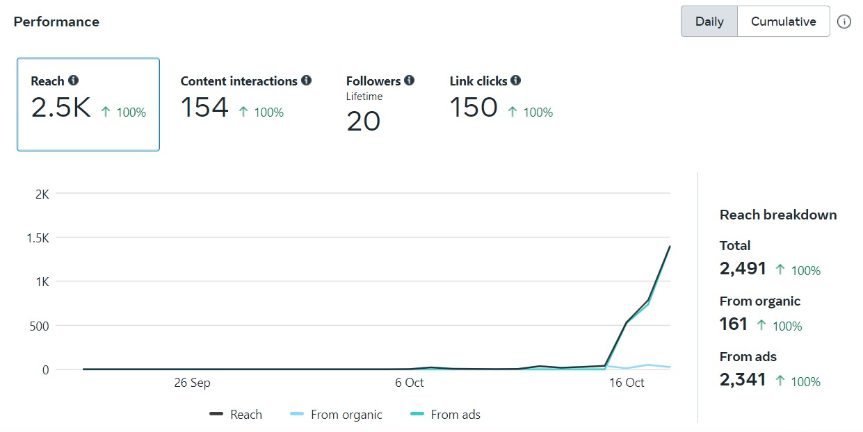
4. Analytic

Slide 56
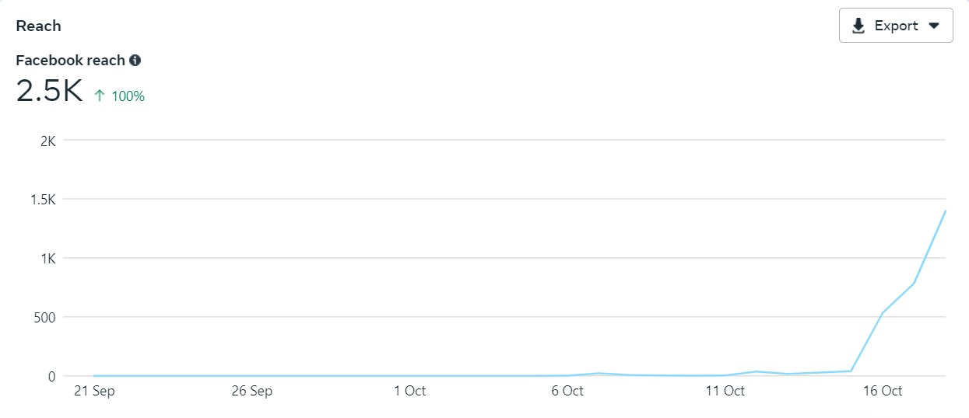
4. Analytic

Slide 57
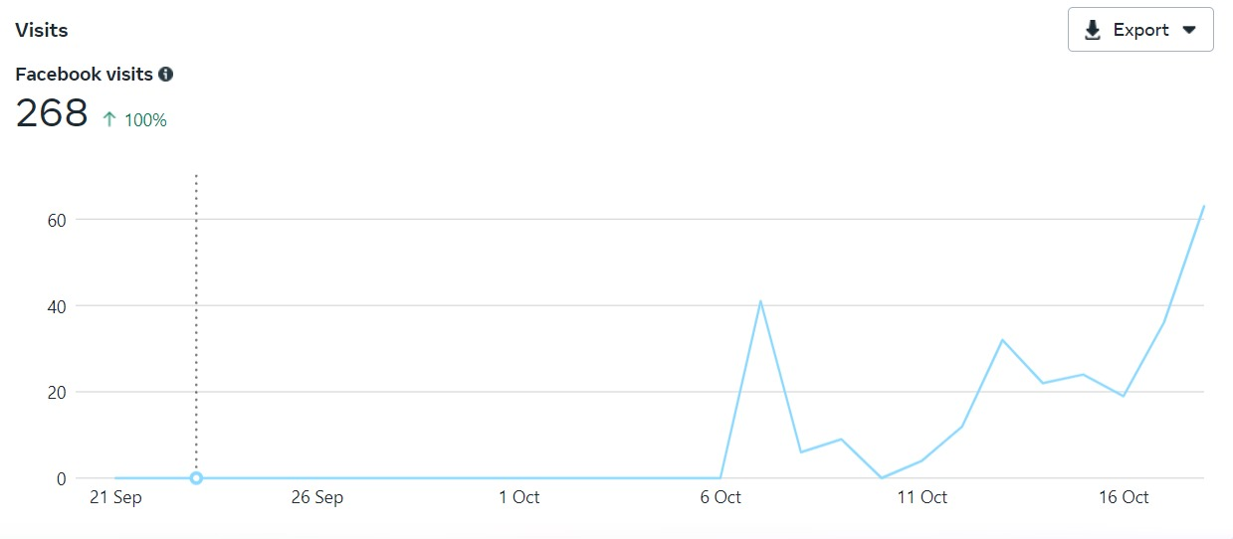
4. Analytic

Slide 58
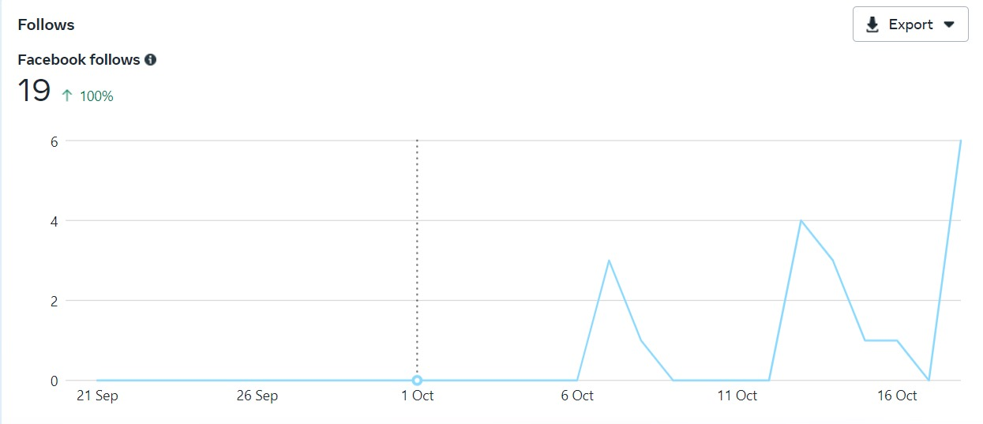
4. Analytic

Slide 59
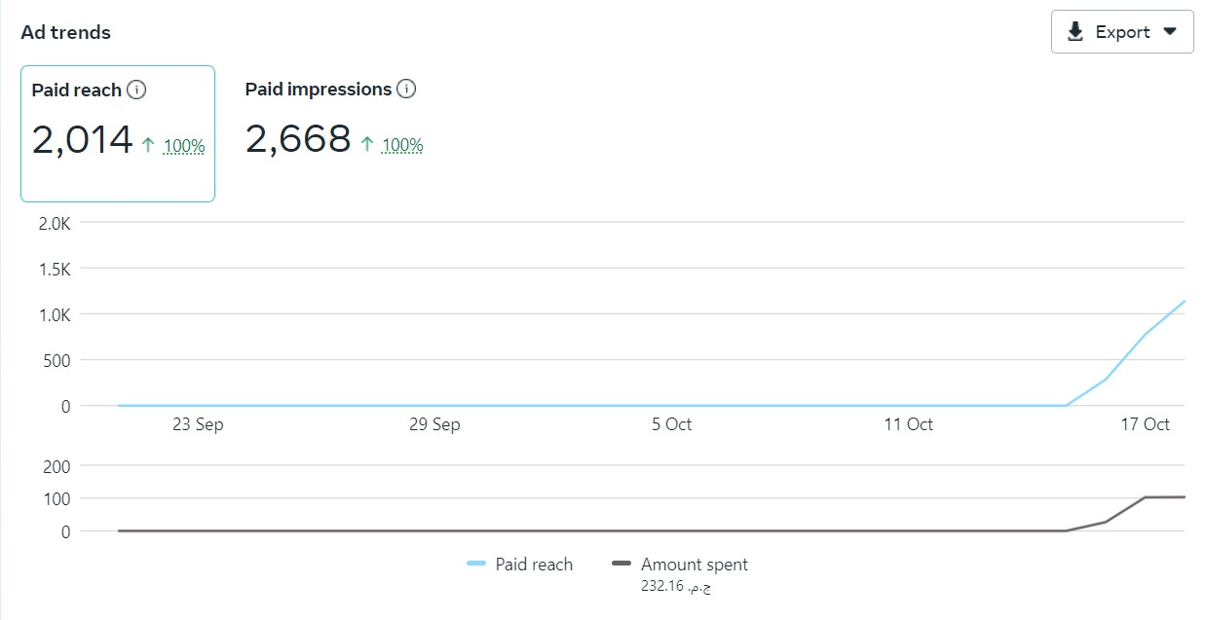
4. Analytic

Slide 60
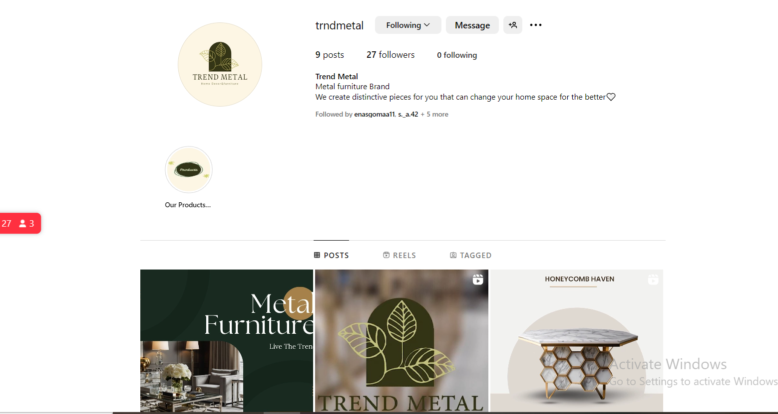
4. Analytic

Slide 61
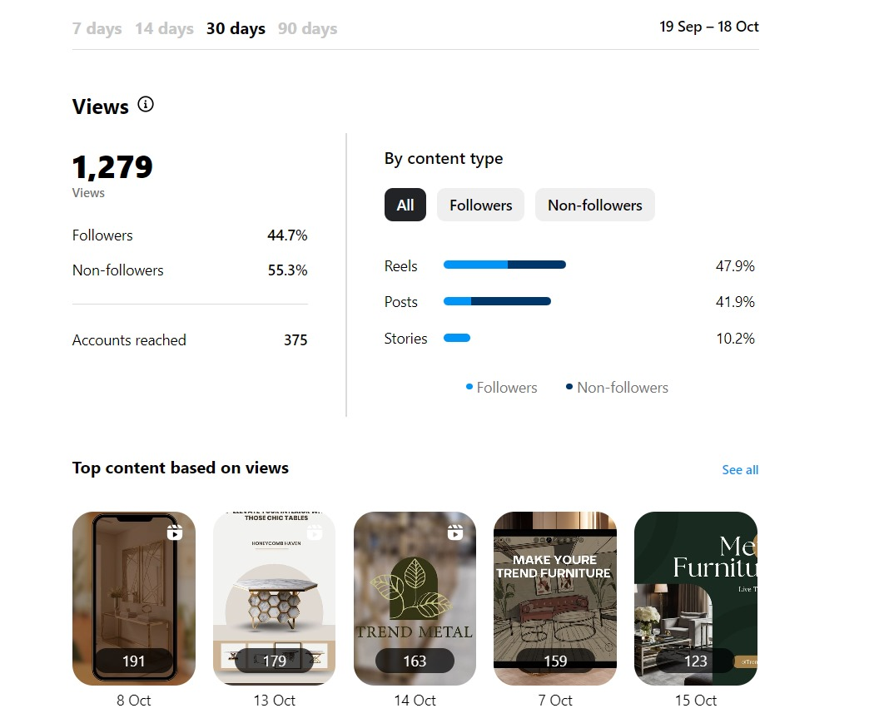
4. Analytic

Slide 62
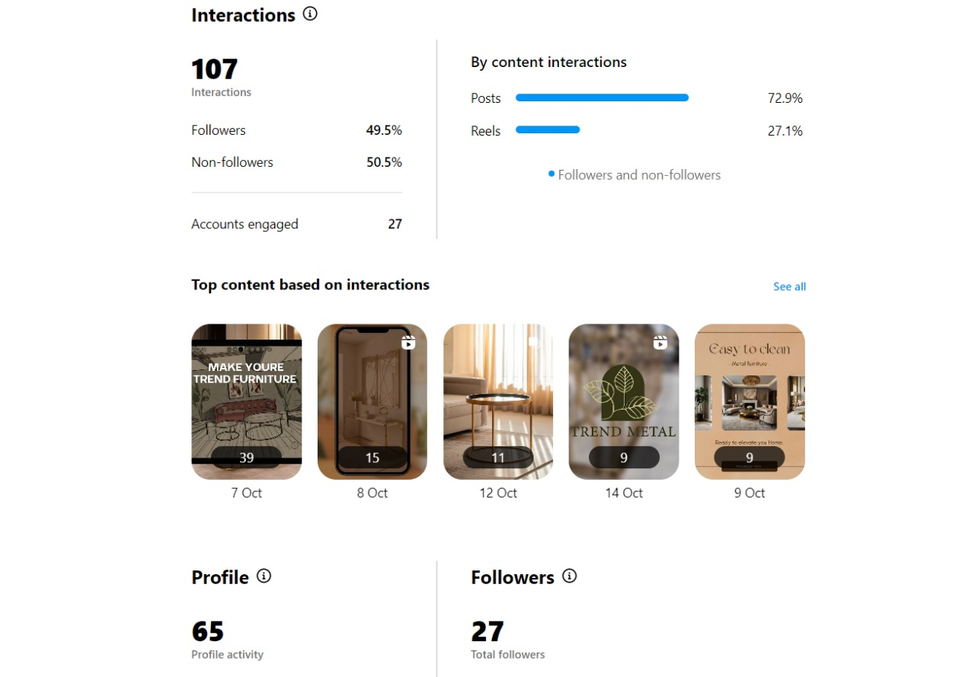
4. Analytic

Slide 63
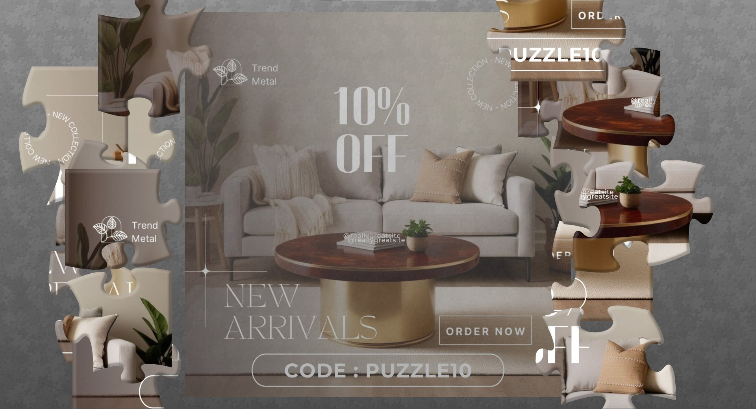
5.What Makes us Special
1- A Jigsaw Game in our Website for fun and Rewarding Experience
The Idea
Customer will enter the link of the Jigsaw Puzzle and after solving it , it will give the Customer a Coupon code to be redeemed in our website

Slide 64
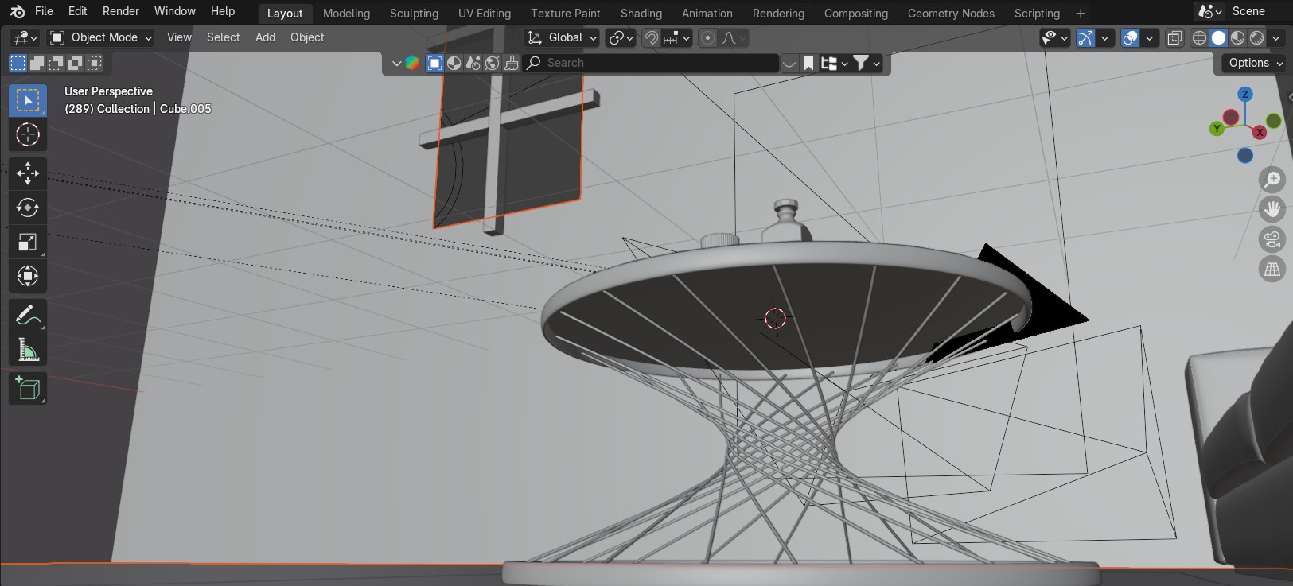
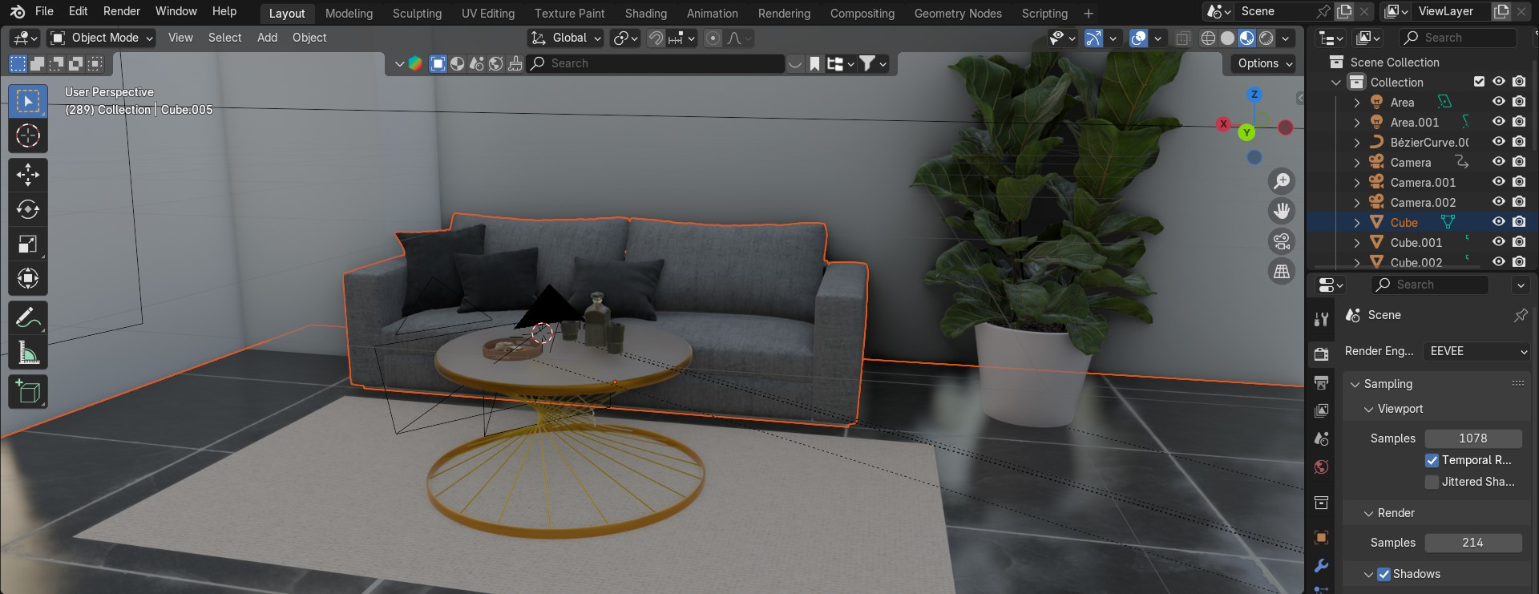
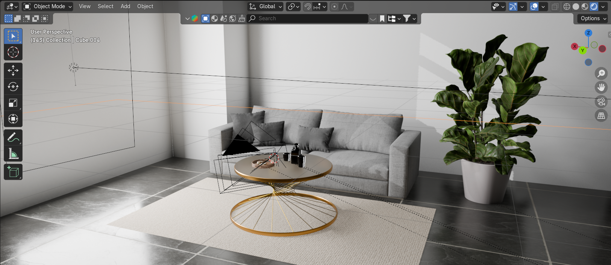
5.What Makes us Special
2- Creating A Customized 4K 3D Rendered Photos of our tables in the customers homes
The Idea
Turning Customers ideas into real-life Designs by 3 Steps :
1-making the modeling
2- giving texture and some style to it 3-fitting it with some great environment and assets matching the shape of the Customer's home

Slide 65
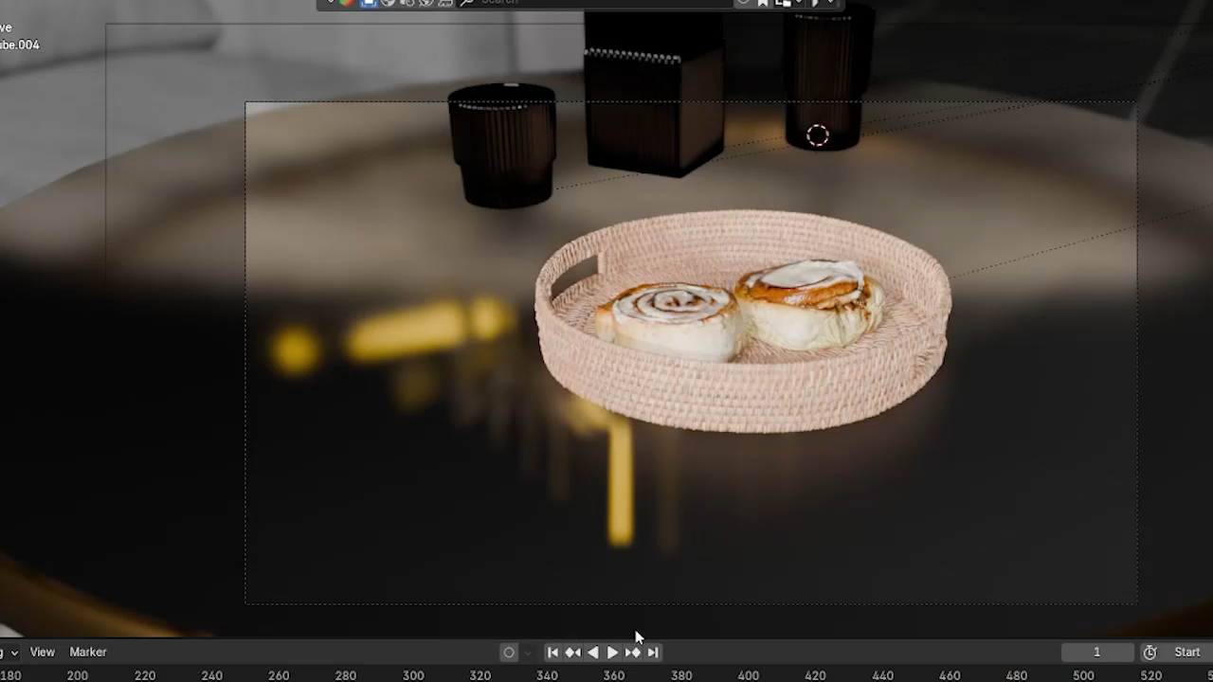
What Makes us Special

Slide 66
Recommendations and improvements:
Referral programs for repeated purchasing
Professional website so customers can order directly to the home
We can use ideas like points and gamification for customers
More advanced photography for better creative and reels
Make a blog to attract new customers
B2B marketing through email marketing for Interior designers, hotels, restaurant, and Café
Offline marketing like a showroom or attending exhibitions
Augmented reality to try our products before buying Snapchat
Make an influencer list for future collaborations

Slide 67

Thank you For All Attention

